Slide 1
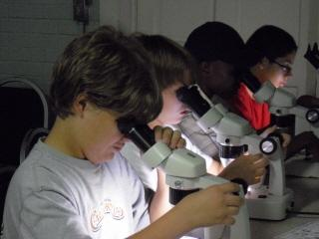
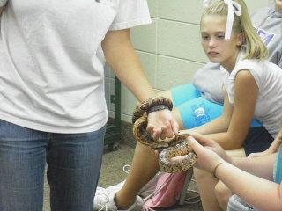
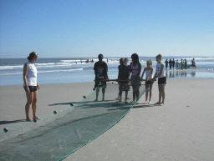
Camp Jekyll 4-H Center
Field Trip
Jekyll Island, Georgia
Oct 16-18, 2019

Slide 2
Forms
2 white forms are yours to keep
  Sample itinerary/packing list
  Remind instructions (half sheet)
Colored forms are due no later than Monday, October 7, 2019
  Pink – Permission Slip/Student Agreement (front and back)
  Green - Informed Consent (front and back)
  Yellow - Jekyll T-Shirt Order Form (half)
Please make certain to fill out all parts so that we don’t have to send back home.

Slide 3
Payments
FINAL PAYMENTS are due no later than Friday, October 11th, 2019 at midnight!
I cannot extend the deadline after that date!

Slide 4
Wednesday, October 16, 2019
Buses will be here @ 6:00 am
PLEASE DO NOT PARK IN THE BUS LANE!
Students arrive between 6:00-6:15 am
Check in with Ms. Parker (Team 701), Ms. Kraemer (Team 702), or Ms. Muise (Team 703).
2 buses-boys on one bus, girls on other, a few girls might have to ride boy bus because of #’s...at least 2 adults on each bus.
Leave as soon as all students check in (by 6:30 AM), but no later than 7:00 AM, whichever comes first
Eat breakfast, bring snacks for bus ride, use restroom before getting on bus!
Don’t be late, students have been left!

Slide 5
Traveling to/from Camp Jekyll
Buses will not stop unless we have an emergency that requires it
Buses are equipped with restrooms
Watch 2 movies
WiFi equipped
Arrive at Camp Jekyll approx 11:00 am
Arrive at LGMS at approximately 5:30 pm Friday afternoon - we will call when we get to Macon

Slide 6
Camp Jekyll Itinerary
Please see the white paper for our schedule/itinerary
We will be VERY BUSY….no news is good news!
I will send REMIND updates periodically as I get service/pictures.
Please join our REMIND Group!

Slide 7
Cabin Life
No girls in boys’ cabins; no boys in girls’ cabins; stay in assigned cabin
No food or drink (other than water) in the cabins
Lights out must be strictly adhered to
Cabins need to be cleaned before leaving on Friday morning - Jekyll staff will check
Parent chaperones will have my cell phone number for issues which arise after lights out
Students will be staying in cabins with parent and teacher chaperones.

Slide 8
Cabin Life
Girls - ? cabins
(?) 16 bed cabins
(?) 32 bed cabins
Boys - ? cabins
(?) 16 bed cabins
(?) 32 bed cabins

Slide 9
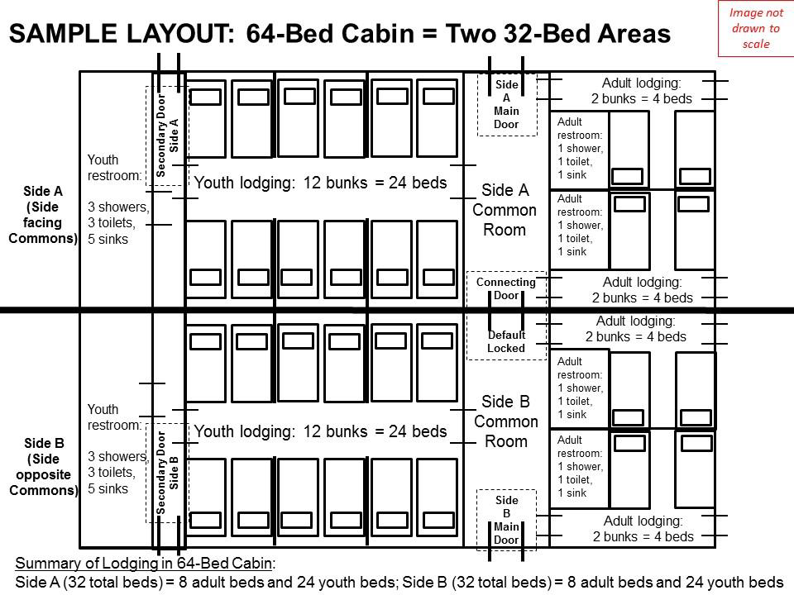

Slide 10
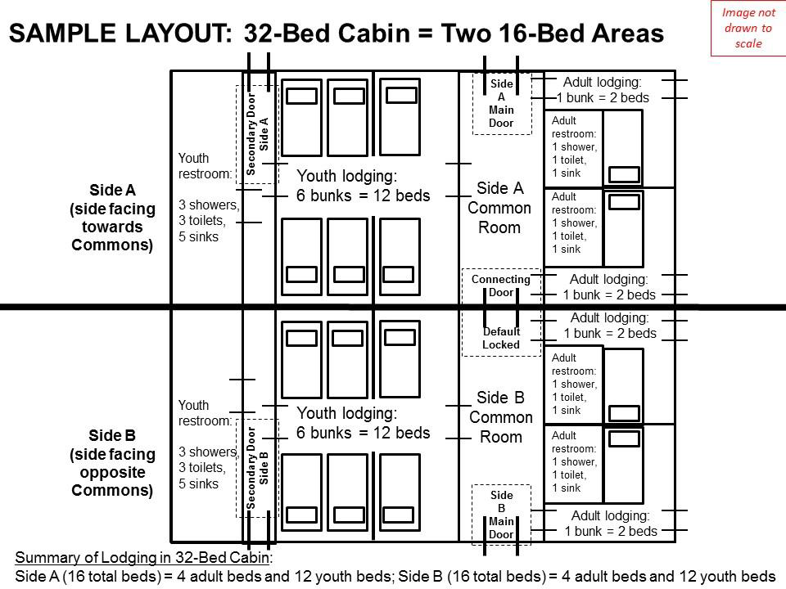

Slide 11
Behavioral Expectations
Students are expected to be on their best behavior and to be respectful of the environment, facilities, Jekyll instructors, teachers, parent chaperones, and their peers.
They will be expected to listen and follow all directions given by these adults.
Discipline issues will be handled on site, with further disciplinary action taken upon return to school if necessary.
Serious disciplinary issues may require parent contact and pick up.
Parent and student must read and sign Student Agreement

Slide 12
Behavioral Expectations
Your parents have paid a lot of money for you to be able to attend this trip, so please don’t take away from this experience for yourself or others by horseplaying, being disruptive, talking excessively, or other negative behaviors.
If a student or parent has any issues with those in the cabin or learning groups, please notify a teacher immediately so that we can handle it promptly.
There will be NO DRAMA on this trip…
This is a unique and wonderful learning opportunity, so please be on your best behavior!

Slide 13
Electronics Policy
YES, YOU MAY BRING YOUR CELL PHONE!!
You may bring electronics to enjoy on the bus, but there are to be no electronics used during class, between classes, during your learning group free play, or at meal time.
Rooms have plenty of outlets.
The only exception is if you ask the instructor and they allow you to take pictures.
Do NOT bring school issued Chromebooks
Bring electronics at your own risk...we are not responsible for lost, stolen, damaged, or missing cell phones, or other electronic devices.

Slide 14
Medication
We will have a supply of generic over the counter medications for minor issues.
Prescription medication needs to be given to Mrs. Foster by the parent before we leave LGMS Wednesday morning. Students should not be in possession of any medication without prior consent.
All medications should be in the original container/box/bottle within a ziploc bag please.
Emergency meds such as EpiPens, inhalers, diabetic supplies will be with the chaperone for the group the student is in.
If possible, drop any meds off to the school nurse prior to the trip - by Friday, October 11th - meds need to be listed on the purple form.

Slide 15
Packing List
2 pairs of long pants (1 non-jean pair) | 2 pairs quick drying shorts (nylon or mesh) | 1 sweater/sweatshirt/ hoodie/jacket
1 lightweight long sleeve shirt | T-shirts | 4 changes of underwear
3 pairs of socks | Old tennis shoes | 1 set of rain gear/poncho
1 hat/cap/visor | Sunglasses | Sleeping bag/bed linens Twin size
Pillow/Blanket | 2 towels/washcloths | Sunscreen
Sunglasses | Water bottle MUST HAVE CAP OR TOP THAT CLOSES | Day pack back pack string bag
Insect repellant | Plastic bag for dirty/wet clothes | Camera/cell phone/charger
Toiletries (toothbrush, toothpaste, soap, deodorant, shampoo, etc.) | Clothes that can get wet and dry quickly for seining and netting class | Optional: Money - Dollar bills or rolls of quarters for canteen/souvenirs

Slide 16
Make-Up Work:
Students are expected to speak with their social studies, language arts, math and connections teachers about work they miss while on the trip.

Slide 17

Souvenir T-shirt

Slide 18
Souvenir T-shirt
A t-shirt is included in the cost of the field trip, so please remind your child not to purchase one separately.
Please fill out the blue (half sheet) t-shirt order form and return to me tonight.
We will distribute t-shirts to students on Thursday evening and ask that students wear them Friday morning for a group picture.
If you are a parent chaperone, please fill out your own order form and indicate that you are a chaperone on the team line.
Leave “Learning Group” blank please - I will fill that in after we assign learning groups.

Slide 19
REMINDERS
Parents, please DO NOT PARK IN THE BUS LANE on Wednesday morning or Friday afternoon so that the buses can park there
Please park in front parking lot and walk to cafeteria
We will call when we get to Macon on the way home

Slide 20
REMINDERS
Parents, please DO NOT PARK IN THE BUS LANE on Wednesday morning or Friday afternoon so that the buses can park there.
We are not responsible for lost, damaged, stolen items such as money or electronics.
Please label all clothes and bedding.
Remind your child they will get a souvenir t-shirt on the trip.
Check weather conditions to make sure your child is prepared.

Slide 21
PARENT CHAPERONES
If you are going on the trip with us, please see Ms. Foster before you leave the meeting tonight!
VERY IMPORTANT!!!

Slide 22
Don’t forget to sign up for the Remind group!

Slide 23
Questions?
Comments?
Concerns?
Suggestions?

